Slide 1
Calendar Application

Slide 2
Team names
1.محيي الدين احمد فتحي احمد
2. مصطفي اشرف مأمون علي
3. مصطفي عبد المحسن حسنين عبد المعطي
4. مصطفي علي محمد علي
5. معاذ عبده عبد الله عفيفي

Slide 3
contents
Program interface .
Months & Days table .
Showing occasion of the year .
Finding day by given date .
Adding notes and events .
Prayer Timing .
Prayer Timing video alert.

Slide 4
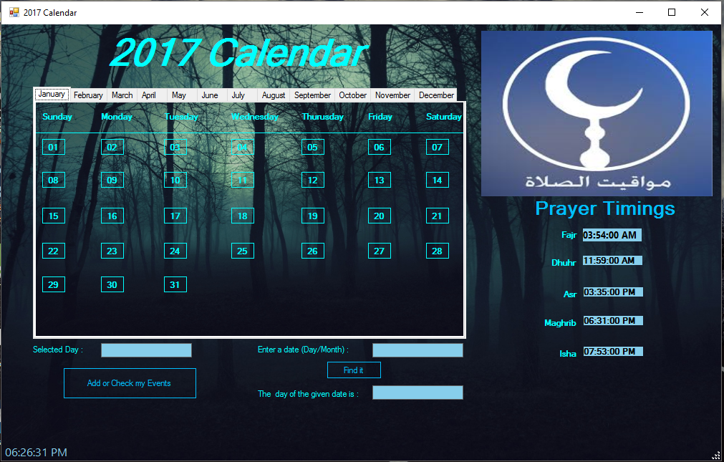
Program interface

Slide 5
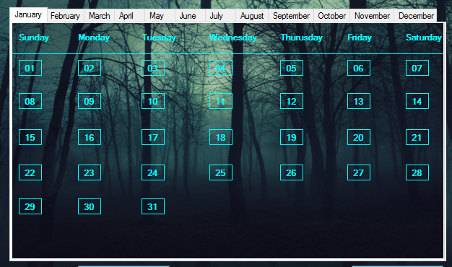
MONTHS & DAYS table

Slide 6
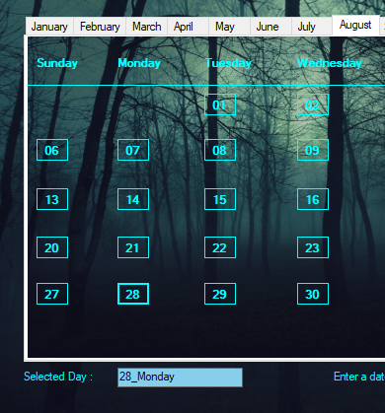
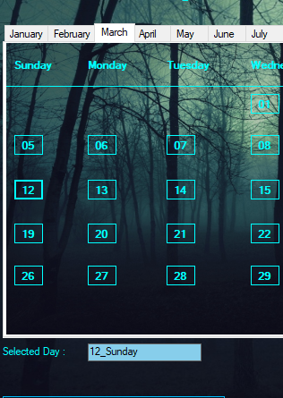
SHOWING SELECTED DAY

Slide 7
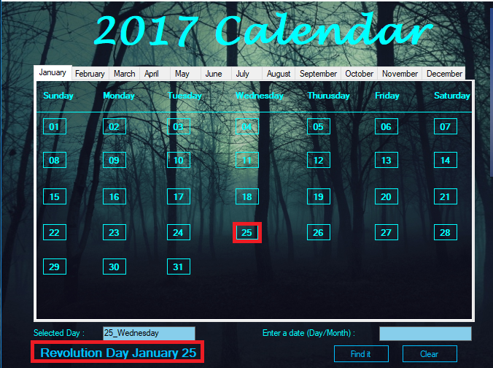
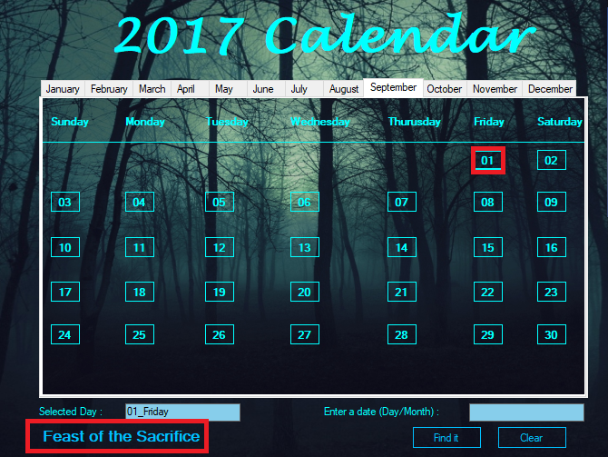
Showing occasion of the year

Slide 8
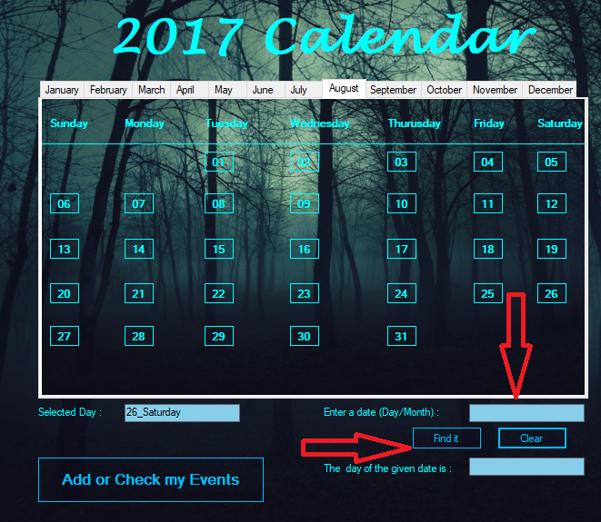
FINDING DAY BY GIVEN DATE

Slide 9
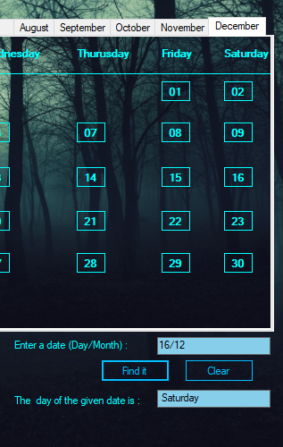
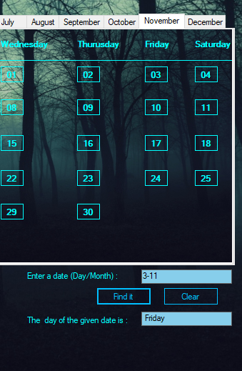
FINDING DAY BY GIVEN DATE

Slide 10
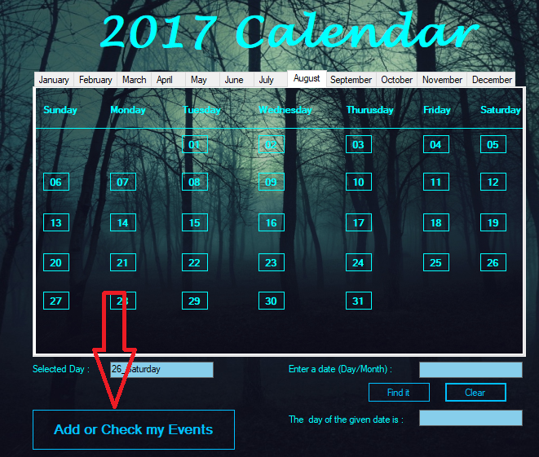
ADDING NOTES AND EVENTS

Slide 11
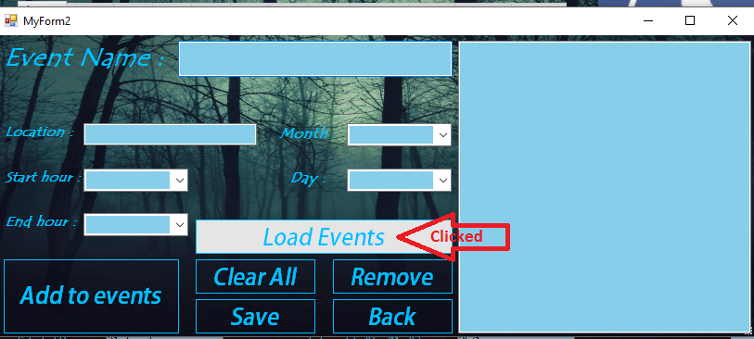
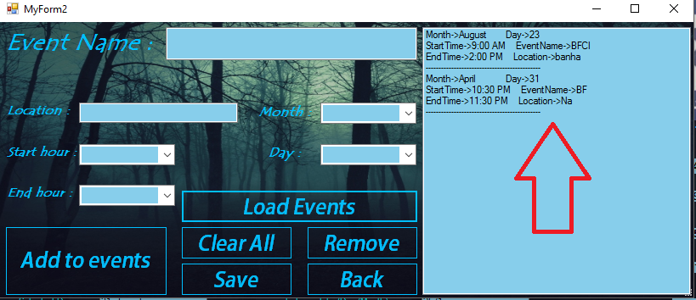
Adding NOTES AND EVENTS

Slide 12
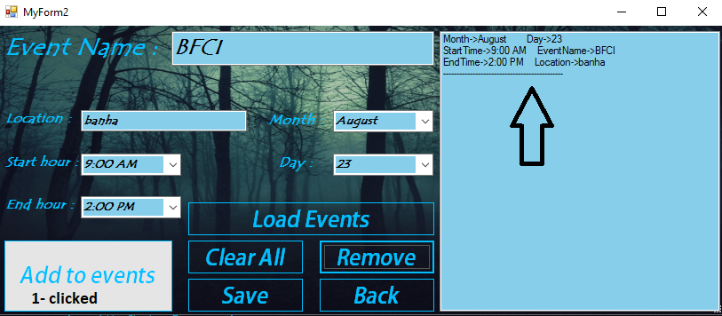
ADDING NOTES AND EVENTS

Slide 13
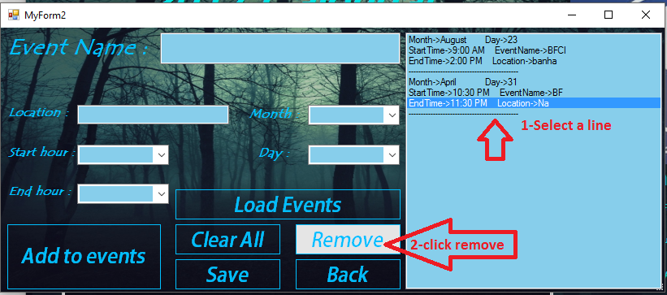
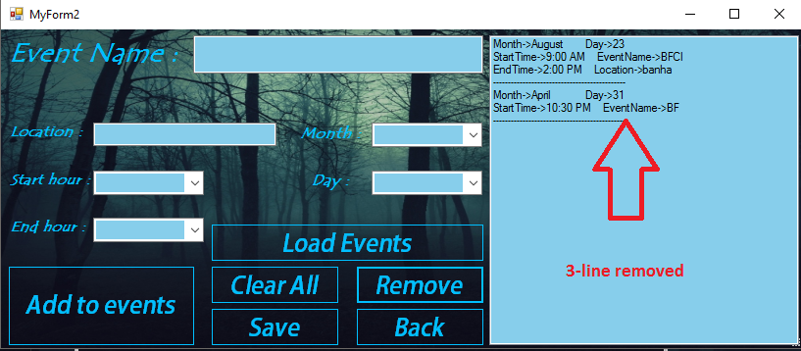
ADDING NOTES AND EVENTS

Slide 14
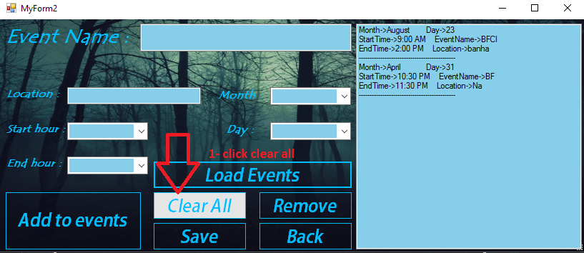
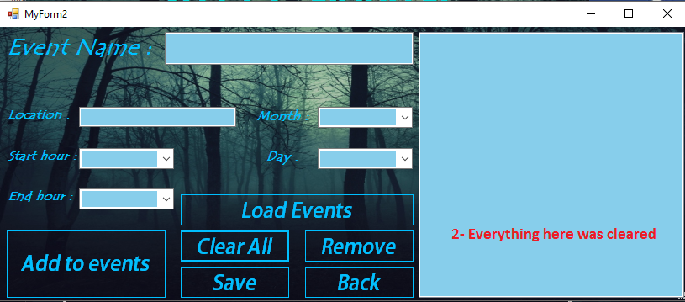
ADDING NOTES AND EVENTS

Slide 15
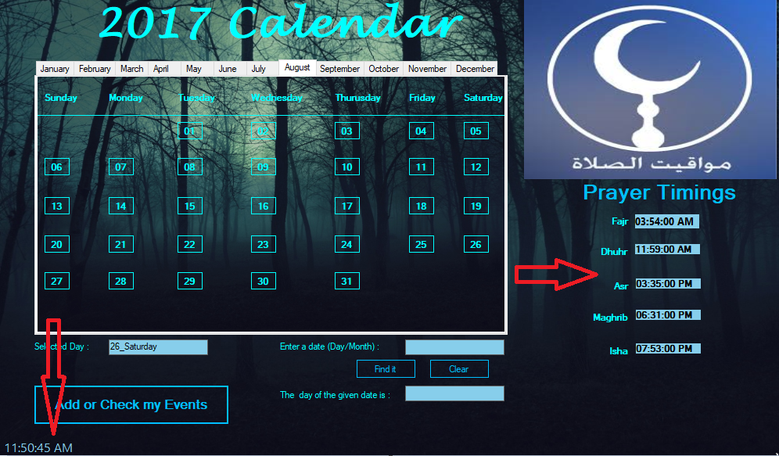
Prayer timing

Slide 16
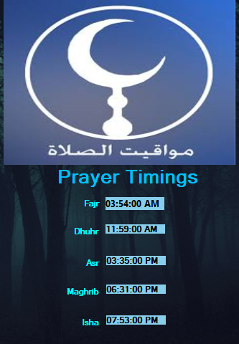
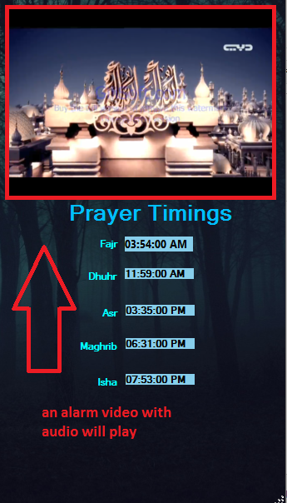
Prayer timing video alert

Slide 17
The end

